Slide 1
Applying machine learning in life sciences:
What does it mean and how to avoid common traps
Ben Goudey
AI Technical Lead
Australia BioCommons

Slide 2
Acknowledgement of Country
I would like to acknowledge Aboriginal and Torres Strait Islander people of the unceded land on which we work, learn and live, particularly the Wurundjeri who are the traditional owners of the land around the University of Melbourne.
I'd like to pay respect to Elders past, present and future, and acknowledge the importance of Indigenous knowledge in the Academy and society.

Slide 3






Ben Goudey: who am I?
AI Tech Lead: Figuring how AI is used in life-sciences, what the barriers are and how BioCommons can help to communities to overcome these
Academic Research
Industrial Research
Postdoc (23/24)
Research Scientist, 13-21
PhD, Comp Sci (2016)
Postdoc (21/22)
Now Data61
PhD, Comp Sci (2016)

Slide 4
Aim of this workshop
By the end of this two day workshop, you should be able to:
Give a high-level description of what machine learning is and what it can do
Understand the basics of evaluating supervised machine learning models
Recognise when evaluation of machine learning models might be optimistically biased
Have a passing familiarity with different models and metrics
Play around with some basic R code for implementing machine learning pipelines

Slide 5
What you will not learn
No in-depth methods or coding
Anything that is not supervised (reinforcement learning, unsupervised learning)
How to run the latest and greatest deep-learning/AI models
Details around data cleaning, engineering, code/data organisation
No worked examples of how to apply AI models to your specific dataset

Slide 6
Content across the two days
Tuesday (Day 1) | Wednesday (Day 2)
Intro to ML Basics of models and evaluation Cross-validation | 4. Tuning models 5. Real-world exploration 6. Discussion and Q/A
Lots of content, fast paced.
More about ideas and high level. Less about code and details Second day can be used to clarify content from first day

Slide 7
Session 1: Concepts

Slide 8
In this session
What is machine learning?
How does machine learning differ from other types of related fields?
What is the most common goal of machine learning?
Introduce some important (and very exciting) terminology

Slide 9
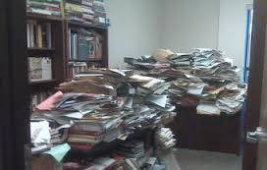
Scenario:
You’ve collected information about a set of samples/individuals.
How do we use this data to infer the probability of some outcome?
Infer risk of disease
Predict if data is low quality
Predict if a given variant is deleterious or not
Please collect your data in a single spreadsheet and not like this pile.

Slide 10
How to use data to inform decision making?
Traditionally, your options are
Domain Expertise
…but this is hard in domains with incomplete knowledge
Statistical modelling
…but now we’re collecting far more data than in the past

Slide 11
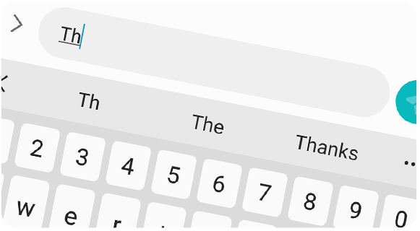
Examples of machine learning in daily life
Predictive text
Spam filtering
Face/fingerprint phone unlock
Recommenders in Netflix/Spotify etc
ChatGPT/Claude/Gemini etc
Notes:
https://github.com/travistangvh/emotion-detection-in-real-time

Slide 12
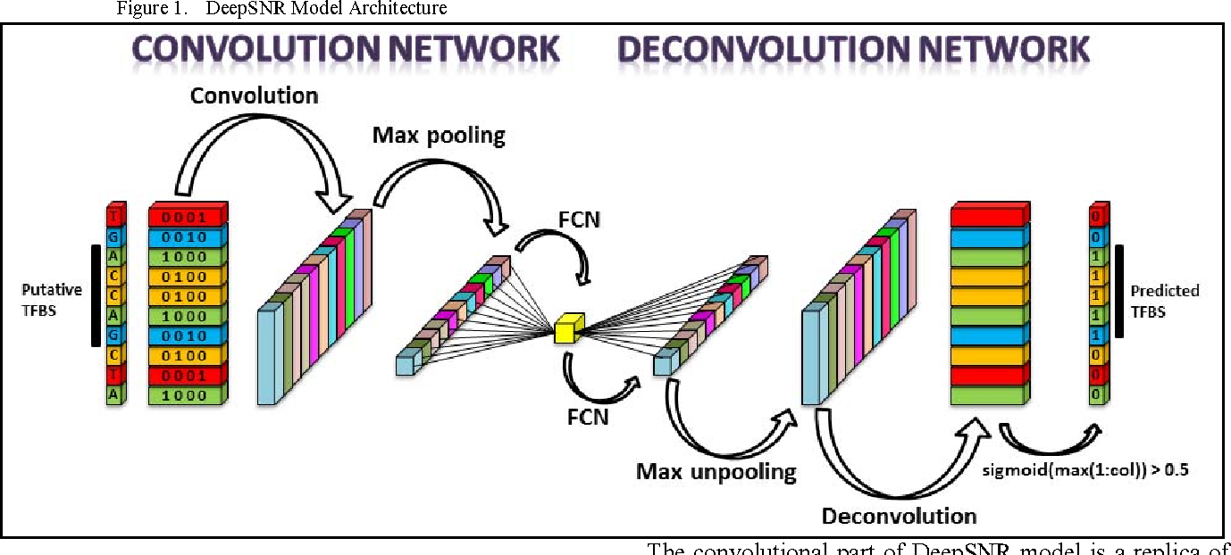
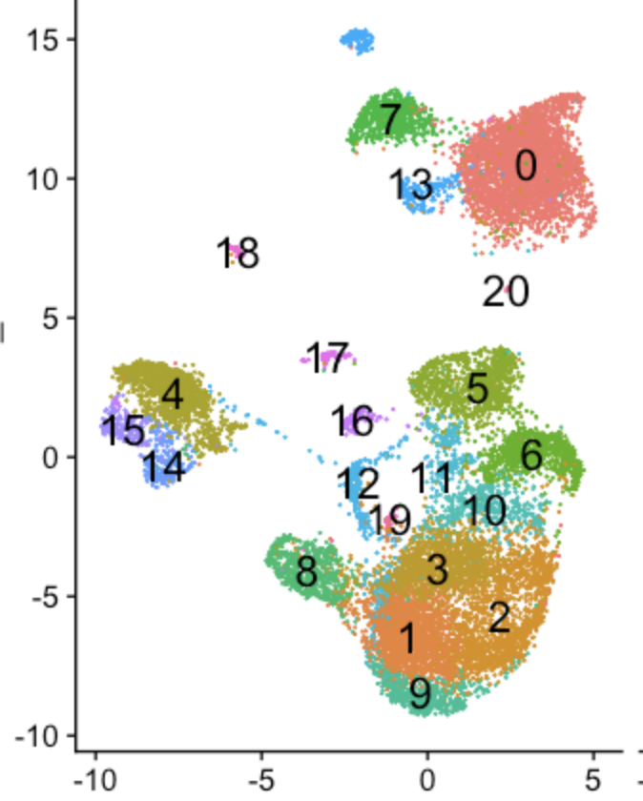
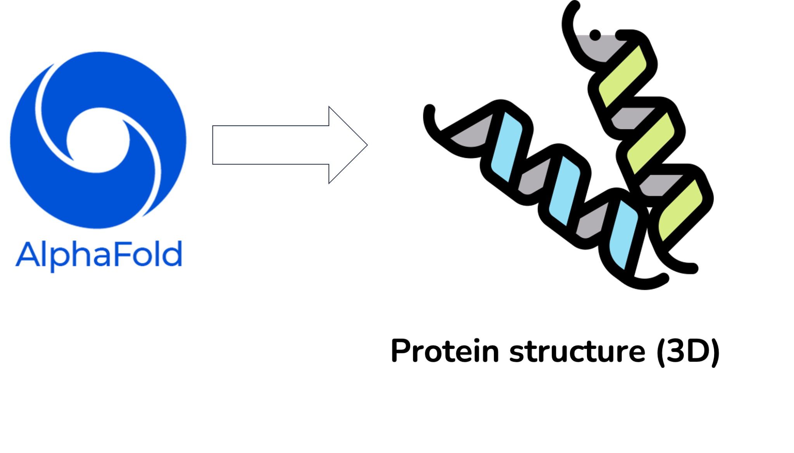
Successful examples of machine learning in bioinformatics
Predicting transcription factor binding locations
Protein structure prediction (e.g. AlphaFold)
Predicting cancer subtypes from gene or mutation signatures
Exploring cell types in scRNA-seq

Slide 13
What is machine learning? Is it just programming?
Algorithms that take data and learn to predict an outcome
Traditional programming
Write a program with explicit rules to follow:
if genome contains mutation 1 then mark risk
if genome contains mutation 2, then mark no risk
if genome contains …
if genome contains …
Machine Learning
Algorithms that take data and learn to predict an outcome
Guess risk from mutations
Classify genomes based on guess strategy
Change strategy to reduce error
Repeat from 1.

Slide 14
Is it just statistics? Good question…
“Classical” statistics = are these variables correlated?
Aim: Understanding the relationships between variables of interest, under certain assumptions
Key problem is usually attribution i.e. which variables are important.
Care less about how well we predict on unseen data.
ML associated with more data, possibly making fewer assumptions about data and view towards predicting something about the data
Key problem is prediction.
Care less about why it works.
Highly recommend Breiman (2001) “Statistical Modeling: The Two Cultures” for a clear discussion on the differences
Notes:
Its not clear cut as we’ll see today

Slide 15
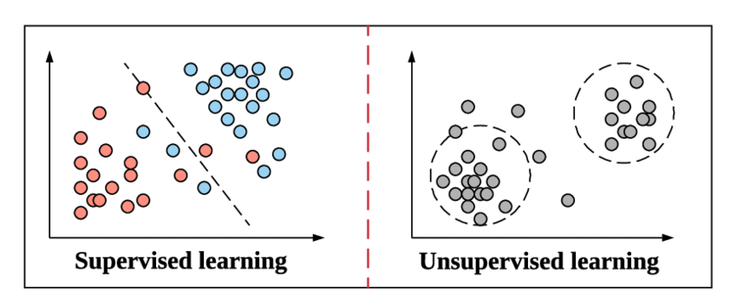
Classes of machine learning techniques
https://arxiv.org/abs/1910.05433

Slide 16

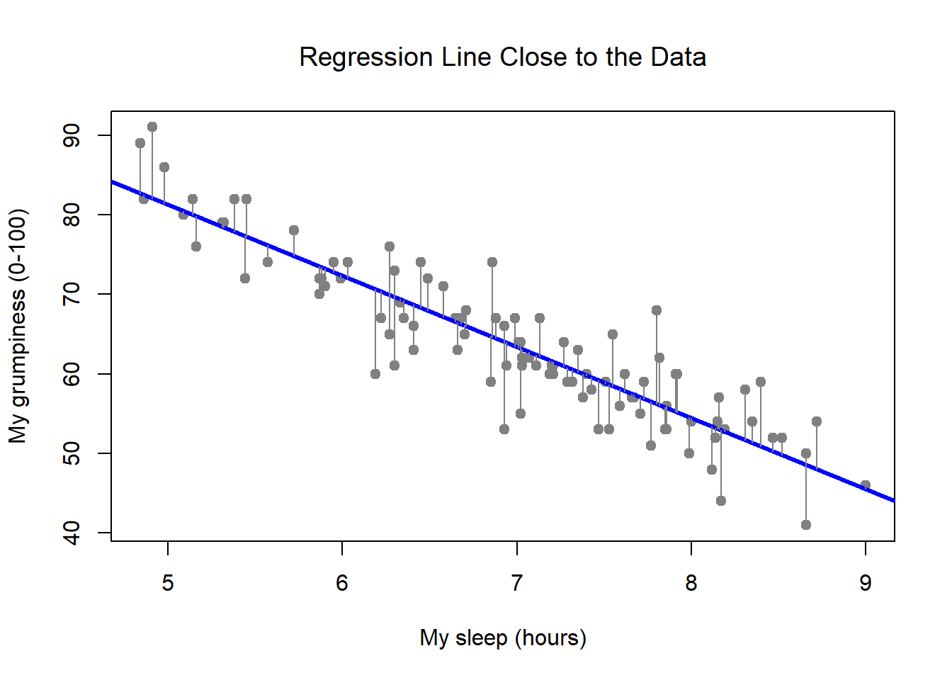
Whats the relationship with AI? What is AI?
“Technology that allows a computer to do something that normally require human intelligence” But practically speaking this is not very helpful
Linear regression
Human-like intelligence
Regression by Danielle Navarro is licensed CC BY-SA 4.0. Original source: https://bookdown.org/ekothe/navarro26/

Slide 17
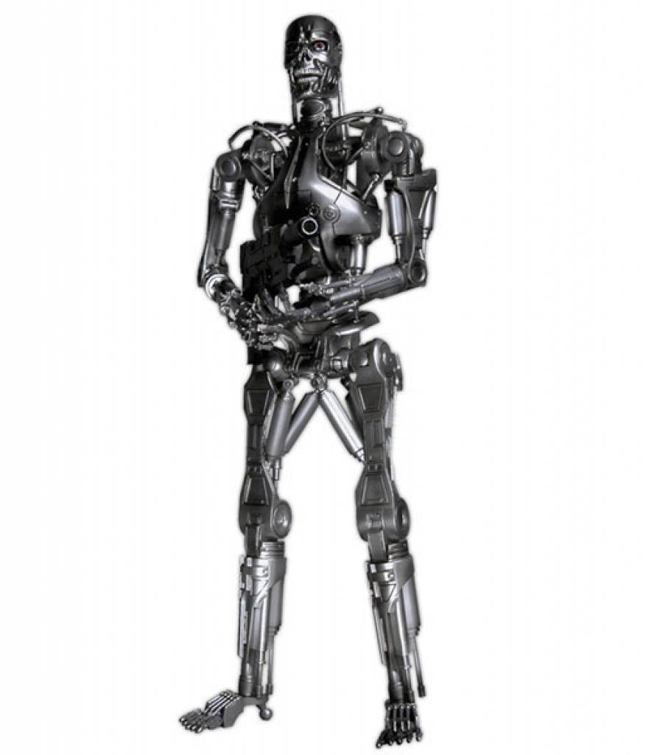
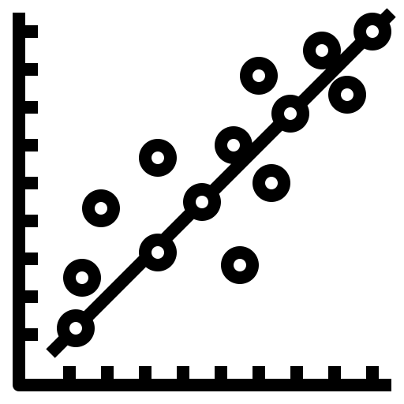
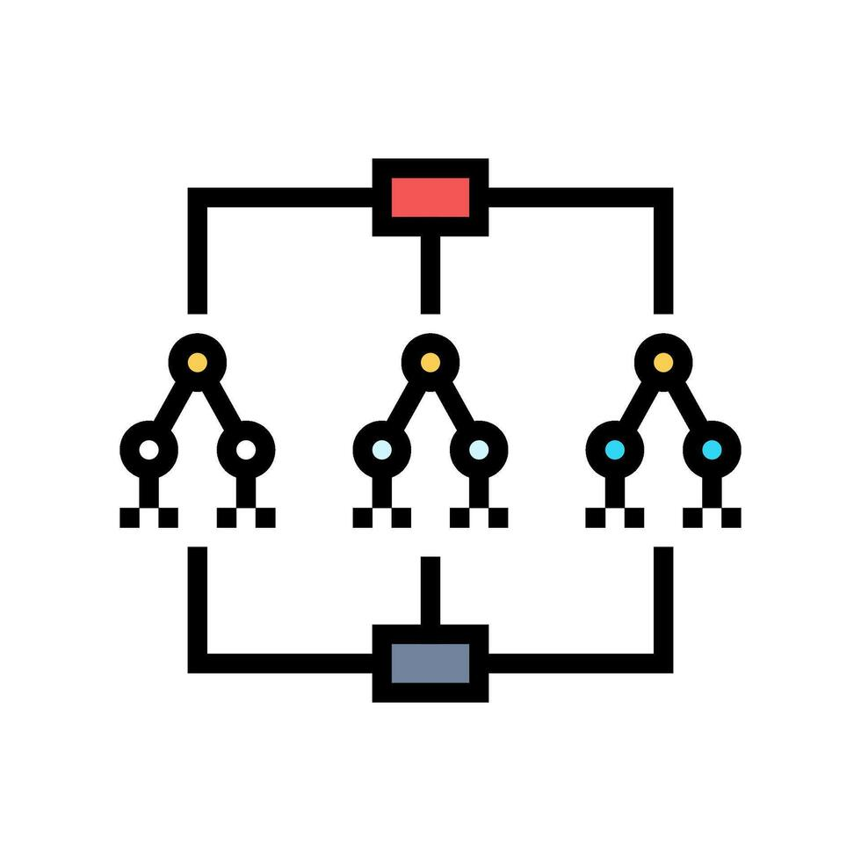
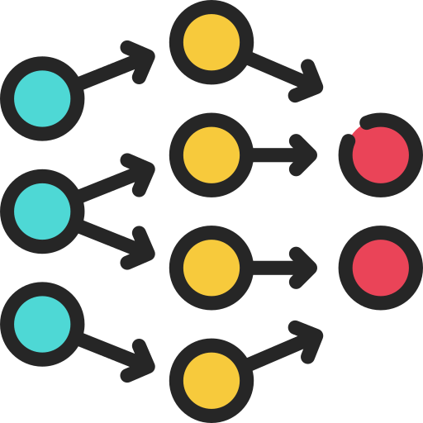
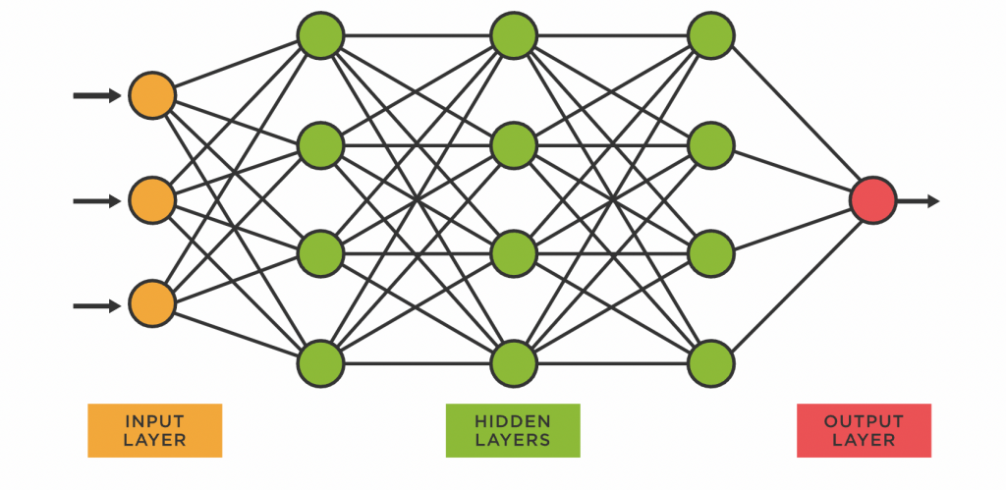
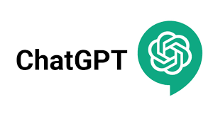

When People Say “AI,” They Might Mean…
Artificial General Intelligence
Machine learning
Deep learning
Large-language models and Generative AI

Slide 18
When People Say “AI,” They Might Mean…
Artificial General Intelligence
Machine learning
Deep learning
Large-language models and Generative AI

Slide 19
When People Say “AI,” They Might Mean…
Artificial General Intelligence
Machine learning
Deep learning
Large-language models and Generative AI

Slide 20


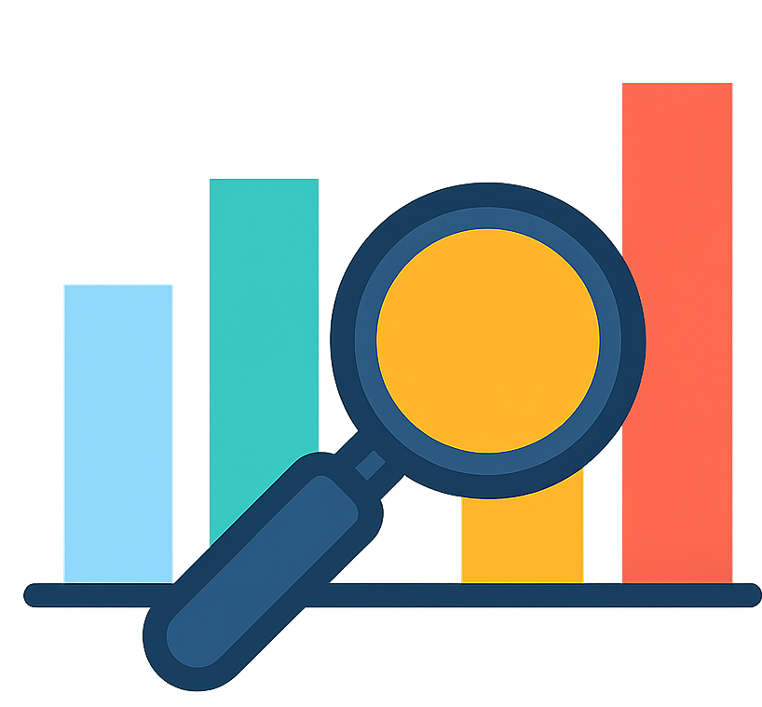
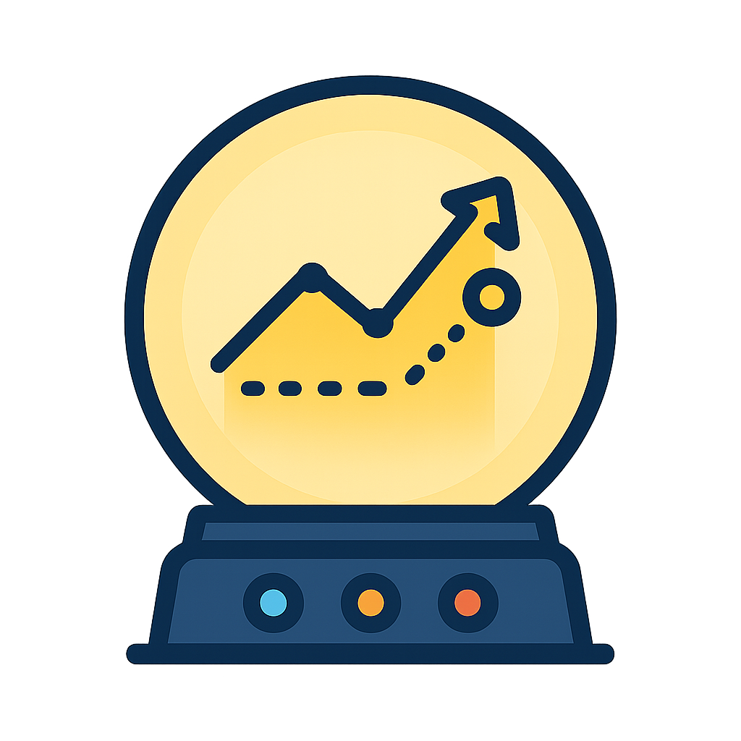
Different goals for supervised ML
Data enhancement/extraction
Multi-modal fusers
Harmonise, impute and standardize
Extract key features and signals.
Combine omics, imaging & cognition into a single disease signature
Quantify predictive value
Personalized risk predictors
Establish how much value measurements actually contribute to prediction on unseen data
Use risk factors to estimate a risk score or time to event, ideally driving intervention
Notes:
And really we covered a lot of different ways that machine learning could be used from data enhancement to quantifying the predictive value of different measurements. But I was always interested in this aspect around personalized risk prediction in AD. One issue was the value of knowing your risk was always of limited value given we had no interventions.

Slide 21
Key terminology to describe a dataset
Samples: different observations in our data (e.g. individuals)
Features: set of measurements that we use (e.g. age, sex, bmi etc)
Also known as the independent variables, regressors, covariates…
y: values to predict
Also known as the dependent variable, response, target…
X: matrix (2D array) of measurements. Size; # samples x # features

Slide 22
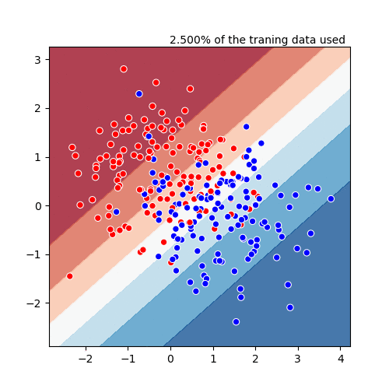
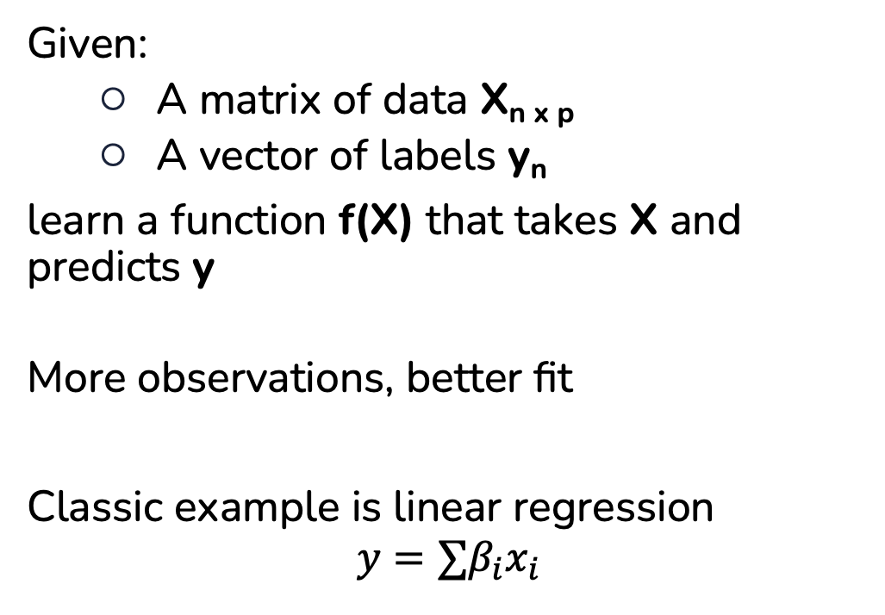
Supervised learning
Given:
A matrix of data X_{n x p}
A vector of labels y_{n}
learn a function f(X) that takes X and predicts y
More observations, better fit
Classic example is linear regression
$$y=∑β_{i}x_{i}$$
Linear regression being fit with increasing number of observations

Slide 23
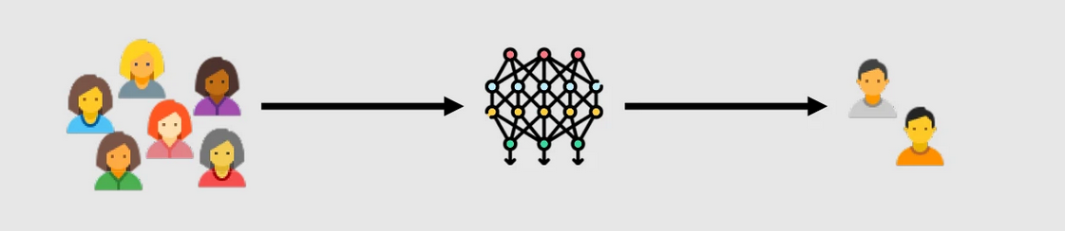
Primary goal: Generalisable predictive model
Data to train model (labels known)
Data we want model to work on (labels unknown)
Can we make a predictive model that will work on data that wasn’t used to train it?
How do we know if we can make predictions on data if we don’t have that data yet?
https://www.nature.com/articles/s41746-024-01127-3/figures/1
Notes:
Imagine we want to construct a model to predict disease progression
For example, could be from pre-diabetic to diabetic in 12 months
We have access to some data from past patients
Use this data to construct model
Our goal is to build a model that works for future patients
Model should provide accurate estimate of who will progress and who will not

Slide 24
Problem: how to assess generalisability from available data
We don’t have any future patients yet, how do we assess model performance?
We hold-out some data and evaluate as if they are unseen.
If we have available data, want to use it to improve out model
More data, better model
Mistakes are very common in this area! Talk more later in this workshop

Slide 25
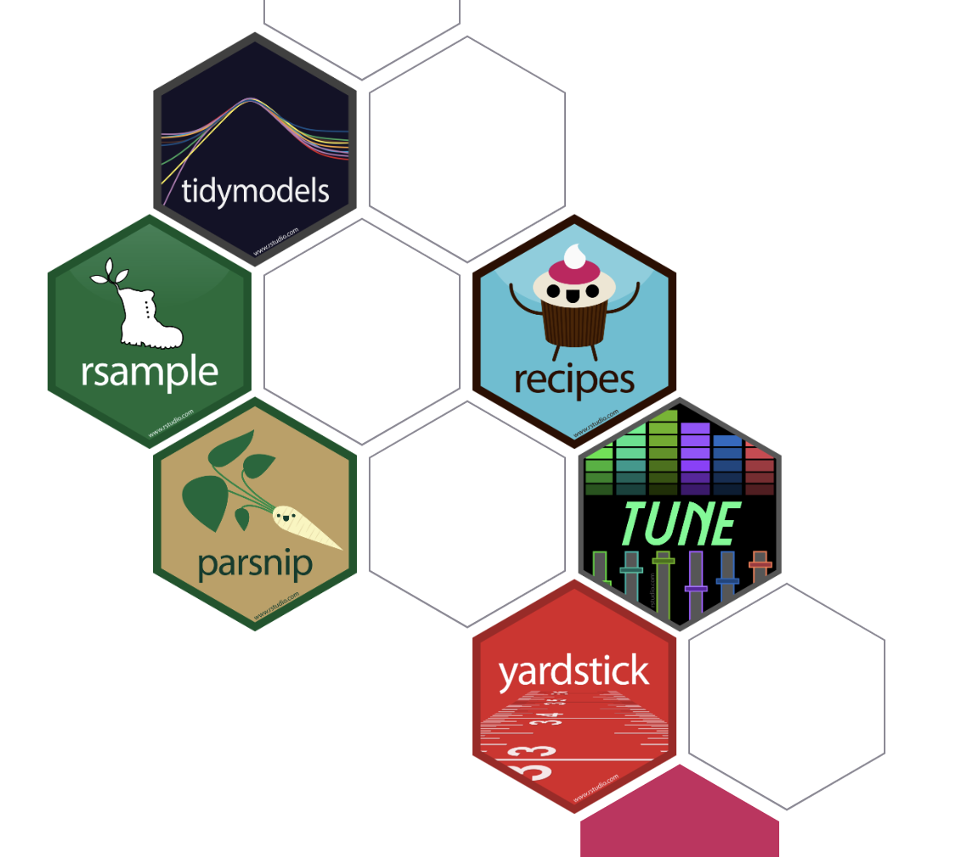
tidymodels
A (maturing) ecosystem of packages for machine learning in R
Pros:
+ Removes a lot of boilerplate
+ Makes it harder to make errors, easier to experiment
Cons:
- Can be restrictive
Data structures can be hard to unpack
- Errors can be hard to understand

Slide 26
Fitting a model in tidymodels
Require a DataFrame X and a set of labels y
Fit a model
logit_spec <- logistic_reg(mode = "classification", penalty = 0, engine = "glm")
Define a workflow
workflow <- workflow() %>%
add_model(logit_spec) %>%
add_formula(diabetes ~ .)

Slide 27
Fitting a model in tidymodels
Define a workflow
model_fit <- workflow %>%
fit(data = data)
Make some predictions
diabetes_train_preds <- predict(model_fit, other_data, type = "prob")

Slide 28
Interactive Session 1

Slide 29
Problem scenario for exploration
Goal: predict diabetes status in 2-7 years based on demographics and blood markers
In particular, does BMI help us to make better predictions?
Real-world, healthcare data from RC Healthcare system in China:
2582 individuals from some sites (use to build the model), 413 from some other site (external data)
We will use different sized subsets of the training data to explore performance
Available covariates: 10 real + unlimited simulated
Patient info:
Age
Sex
BMI
Blood pressure
Blood measures
Total cholesterol
Low/high-density lipoproteins (HDL/LDL).
Fasting glucose
Serum triglycerides level
Simulated
Just random noise. We use these to simulate when you have a whole collection of measurements, many unassociated with outcome.
Notes:
Blood measures:
Total cholesterol
Low/high-density lipoproteins (HDL/LDL).
Blood sugar levels
Serum triglycerides level
Simulated:
Just noise!

Slide 30
Notes about the code
There is lots of it! Idea is not to understand it all but to explore and adapt what is there.
There are some conflicts when you load in the R packages – don’t worry about these, they cause no issues here.
There is a function: load_diabetes_data(df, nsamples=400, add_n_features=10)
This is a wrapper I wrote for the workshop that subsets the data to have nsamples and which adds add_n_features of `noise` features which are unrelated to diabetes.
These noise features simulate having measurements in your data that are totally un-related to the outcome you are measuring. This happens in real life: untargeted proteomics, large collections of clinical data etc

Slide 31
Interactive session 1
Get Google Colab working
Explore the diabetes dataset
Fit a model on some real data
Get some outputs that we’ll talk through in more detail in the next section.

Slide 32
Return from interactive session 1
Observed that its easy for model performance on one dataset not to match performance on another:
Occurs more as number of features increases
Occurs less as the number of observations increases
Both are common situations in bioinformatics and clinical applications
Lots of complications, even in a small dataset

Slide 33
Session 2: Models and evaluation frameworks
Notes:
IN the previous section, we saw that a model fit on the data didn’t generalize as number of noisy features grew.
Despite being a simple linear model, we overfit to the data that we had at hand.
There are a variety of ways to control model complexity, depending on the models and strategies employed.

Slide 34
In this session
Measuring predictive performance
World’s fastest tour of machine learning models
Ideas about over-fitting

Slide 35
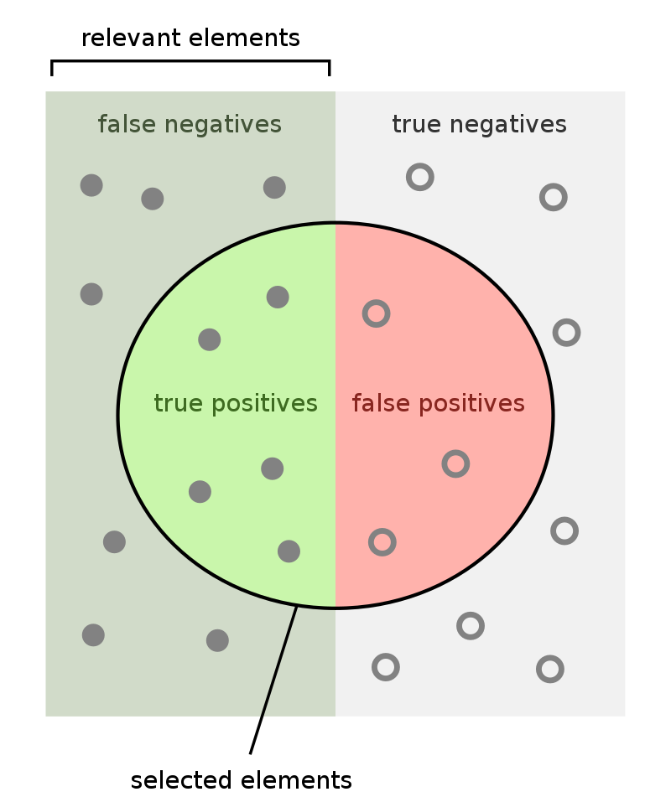
Measuring discrimination
Imagine a classifier that outputs a binary decision (true/false)
True positive (TP) rate
Proportion of positives correctly identified
False positive (FP) rate
Proportion of negatives incorrectly identified
By FeanDoe - Modified version from Walber&#039;s Precision and Recall https://commons.wikimedia.org/wiki/File:Precisionrecall.svg, CC BY-SA 4.0, https://commons.wikimedia.org/w/index.php?curid=94134880

Slide 36
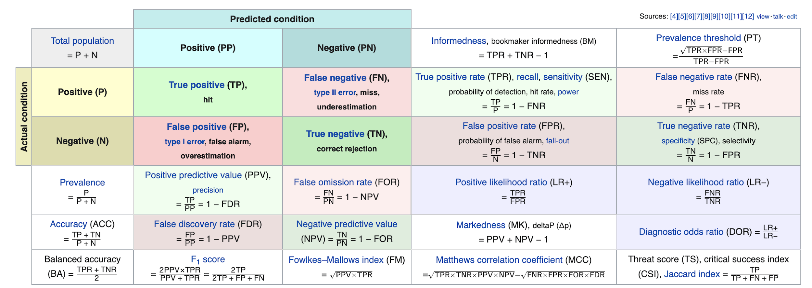
Accuracy and balanced accuracy

Slide 37
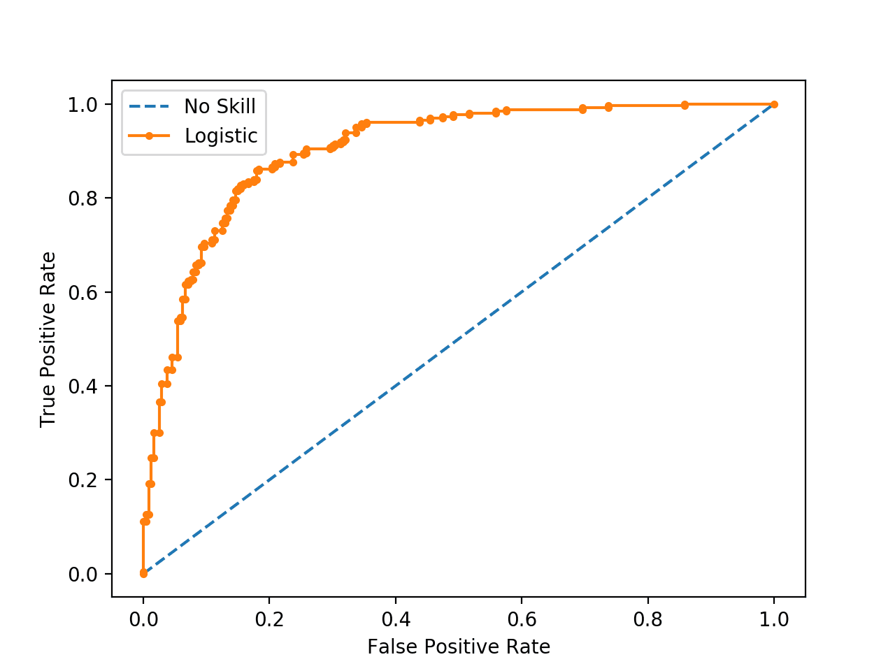
But what about ROC curves and AUC
Used everywhere! But what do we compute them?

Slide 38
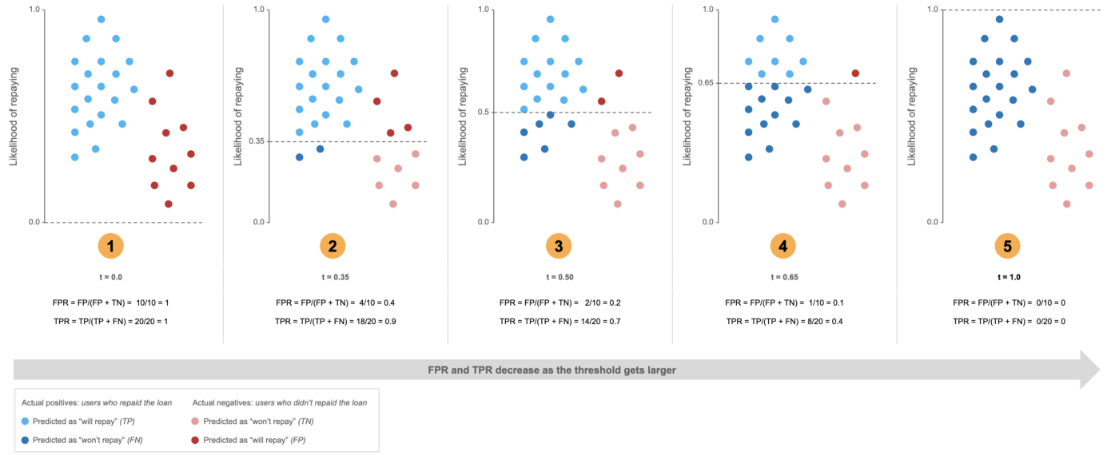
How to construct a ROC curve
Positive class (repaid) is blue y-axis, more likely to repay Threshold=0 == All predicted positive
Imagine a binary classifier that outputs a continuous value
Could be a probability or just a score
To make a binary classification, we need to threshold the output into two classes.
ROC Curve examines TPR and FPR at all thresholds
https://towardsdatascience.com/understanding-the-roc-curve-in-three-visual-steps-795b1399481c#

Slide 39
How to construct a ROC curve
Notes:
https://towardsdatascience.com/understanding-the-roc-curve-in-three-visual-steps-795b1399481c#

Slide 40
How to construct a ROC curve
Notes:
https://towardsdatascience.com/understanding-the-roc-curve-in-three-visual-steps-795b1399481c#

Slide 41
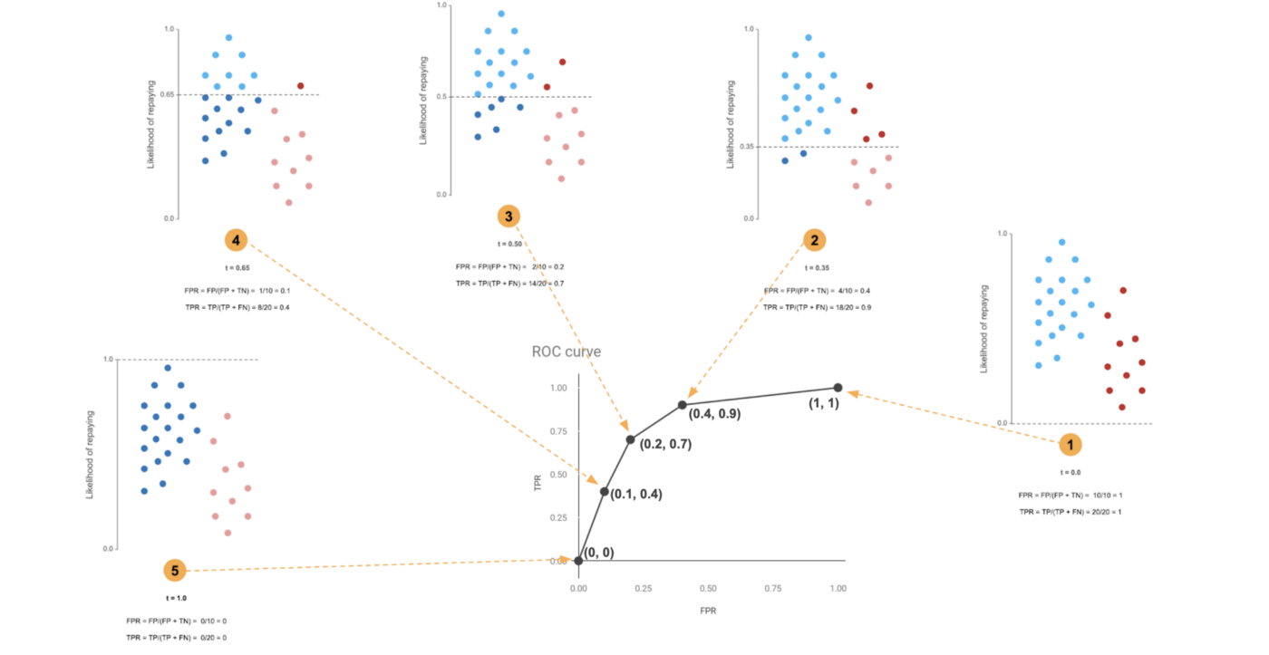
How to construct a ROC curve
Index | Threshold | FPR | TPR
1 | 0.0 | 1 | 1
2 | 0.35 | 0.4 | 0.9
3 | 0.5 | 0.2 | 0.7
4 | 0.65 | 0.1 | 0.4
5 | 1.0 | 0 | 0
Table showing the resulting data points. NB: these should be over all possible decision thresholds, i.e one point per unique prediction
Notes:
https://towardsdatascience.com/understanding-the-roc-curve-in-three-visual-steps-795b1399481c#

Slide 42
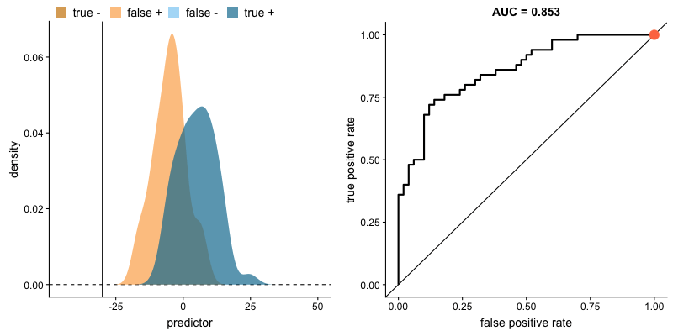
Receiver operating characteristic curve (ROC) & area under curves (AUC)
Imagine a classifier that outputs a scores. How do we evaluate?
https://paulvanderlaken.com/2019/08/16/roc-auc-precision-and-recall-visually-explained/

Slide 43
Which metric to pick is context specific
Accuracy and AUC are measures of performance overall
In screening, we may only be interested in very high or very low risk individuals
Here, PPV and NPV may be more interesting
Costs can also be integrated into these scores to incorporate the cost of measurements or mis-labelling

Slide 44
A quick tour of some machine learning models

Slide 45
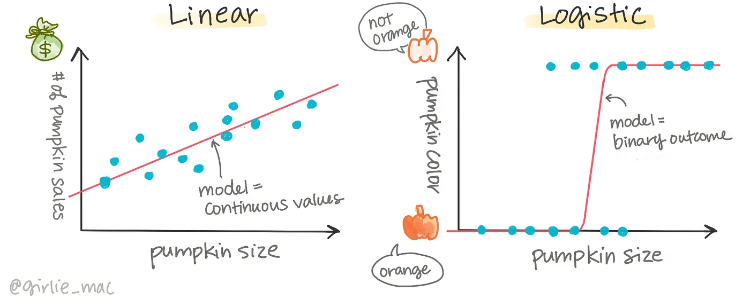

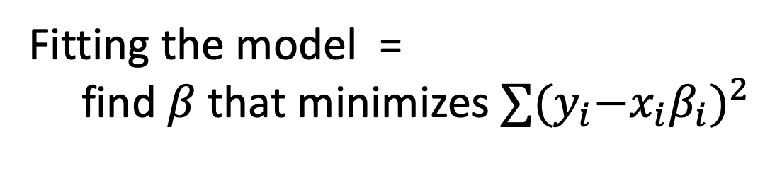
Linear or Logistic regression
Problematic when:
# features > # samples
features are highly correlated

Slide 46
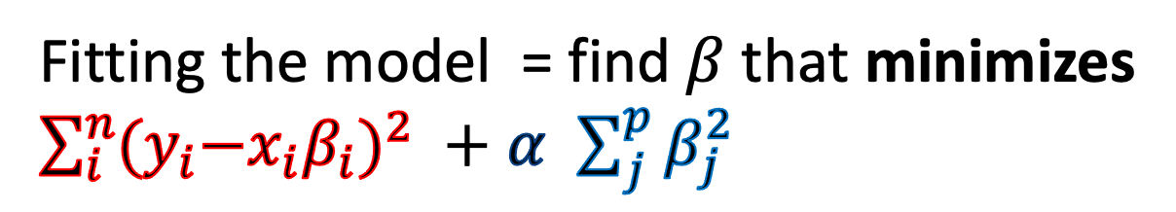
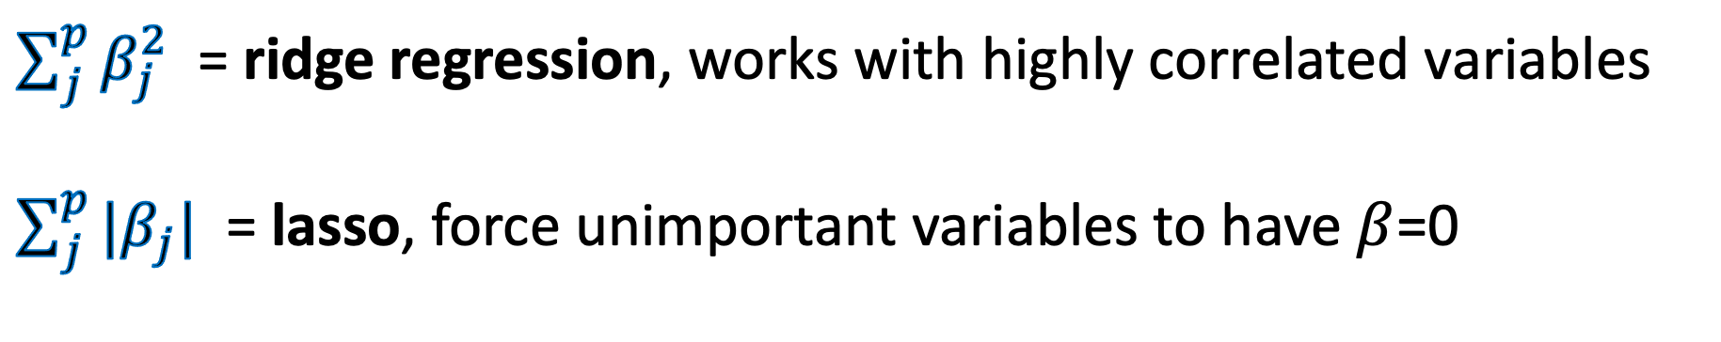
Penalized regression
Model fit
Penalize large coefficients
Controlling parameter!

Slide 47
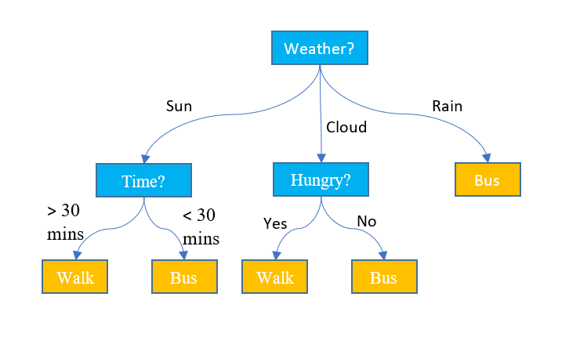
Decision tree
Pros:
Very flexible modelling family
Make no assumptions about relationship between features and target
Easy to visualise
Con:
Tend to under or overfit
Very sensitive to small changes in the data
What mode of transport should I take?
Notes:
Linear models assume linear relationship with outcome
What if we don’t know the relationship
What if we want to allow for interactions

Slide 48

Random Forest
Pros:
Very flexible modelling family
Make no assumptions about relationship between features and target
Robust and often accurate
Insensitive to most parameters
Con:
Hard to interpret
By Venkata Jagannath - https://community.tibco.com/wiki/random-forest-template-tibco-spotfirer-wiki-page, CC BY-SA 4.0, https://commons.wikimedia.org/w/index.php?curid=68995764
Notes:
Linear models assume linear relationship with outcome
What if we don’t know the relationship
What if we want to allow for interactions

Slide 49
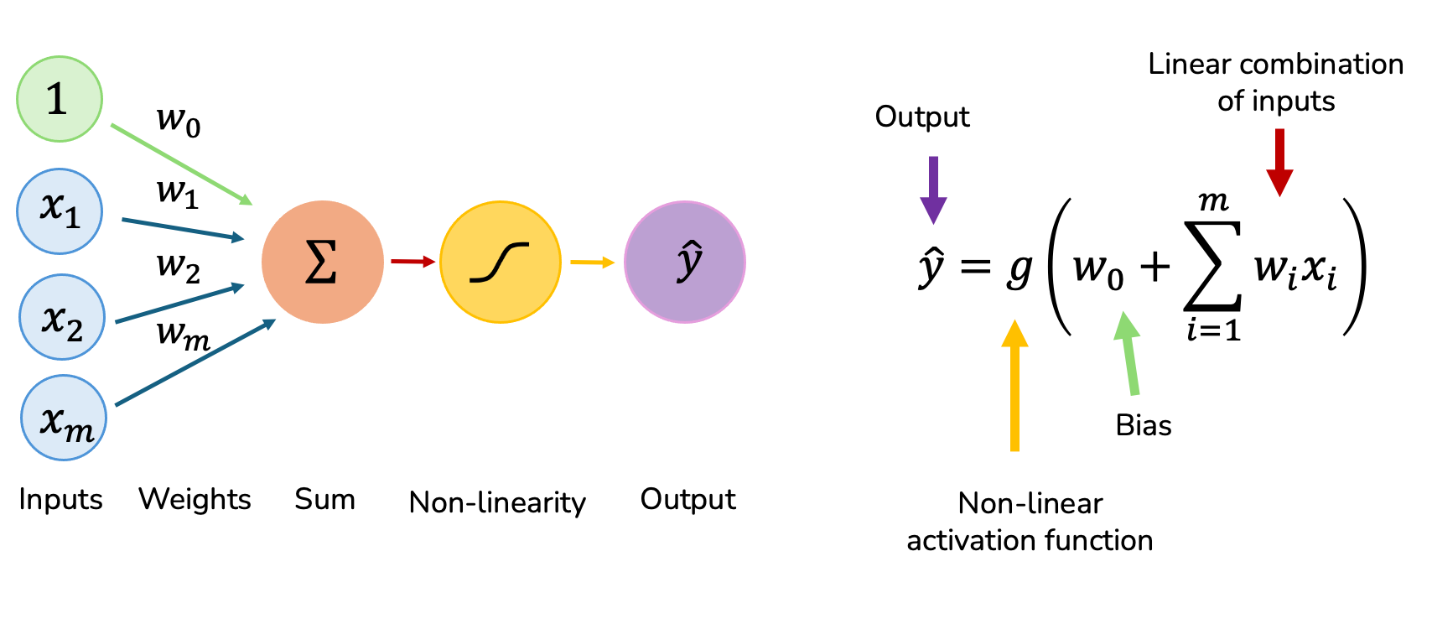
Neural network
Simple NN is like regression

Slide 50
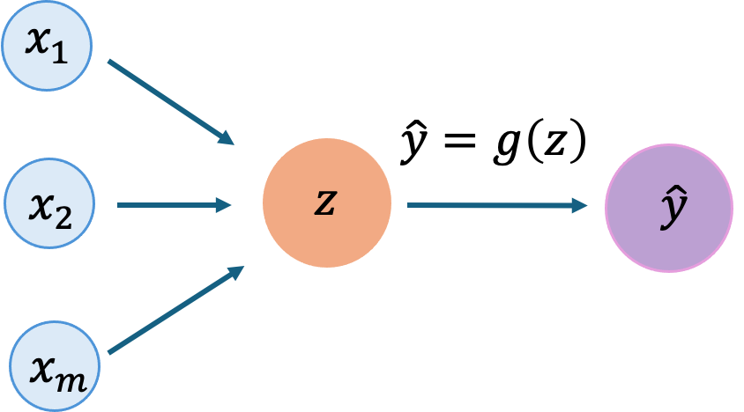
Neural network (simplified)
A model like this is almost the same as regression.
Can still only model fairly linear functions.
Hidden layer Size=1

Slide 51
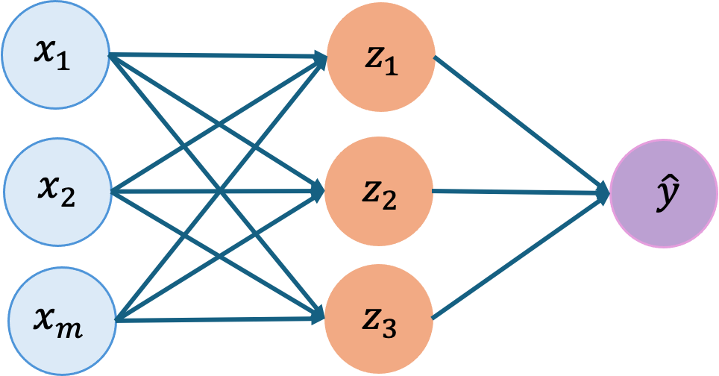
Neural network - more neurons, more flexibility
A model like this is a lot more flexible than regression. Can model non-linear functions. Flexibility grows with hidden layer size.
Hidden layer Size=3

Slide 52
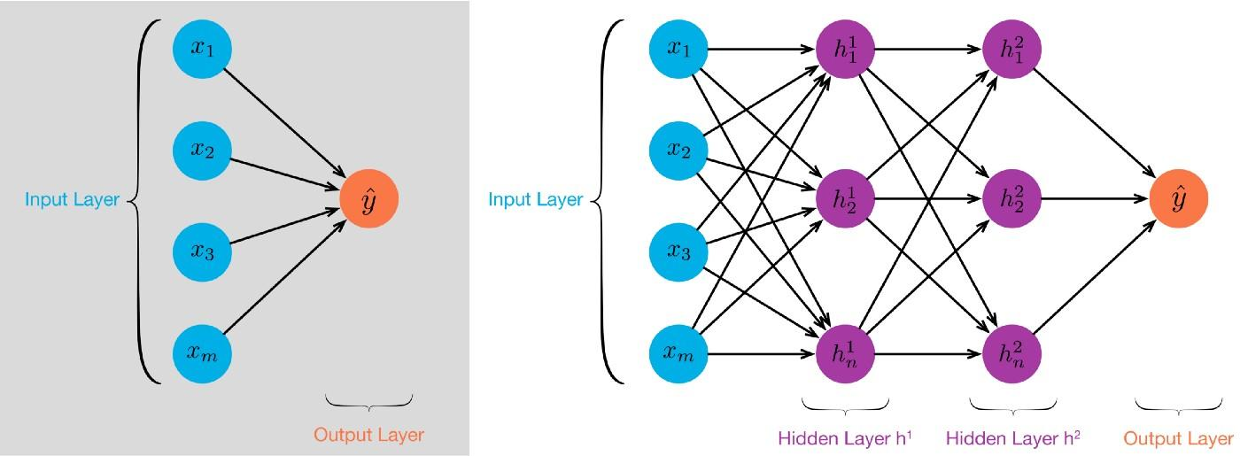
Deep learning
Neural networks with multiple stacked layers

Slide 53
Cool models but when do these models help?
We want the models we create on a given set of data to work on the datasets we want to apply the models to
Data I want my model to make predictions on
Data I have today
Collected in the future
Collected in a different country
Collected with a different cohort design

Slide 54
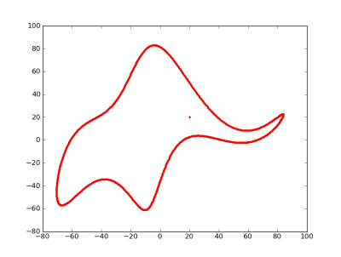
Model complexity and overfitting
John von Neumann famously said
“With four parameters I can fit an elephant, and with five I can make him wiggle his trunk.”
Increasing model expressivity and large data makes evaluation critical
Someone took the quote literally Mayer al (2010) “Drawing an elephant with four complex parameters”, Am. J. Phys. 78, 648 (2010), doi.org/10.1119/1.3254017.

Slide 55
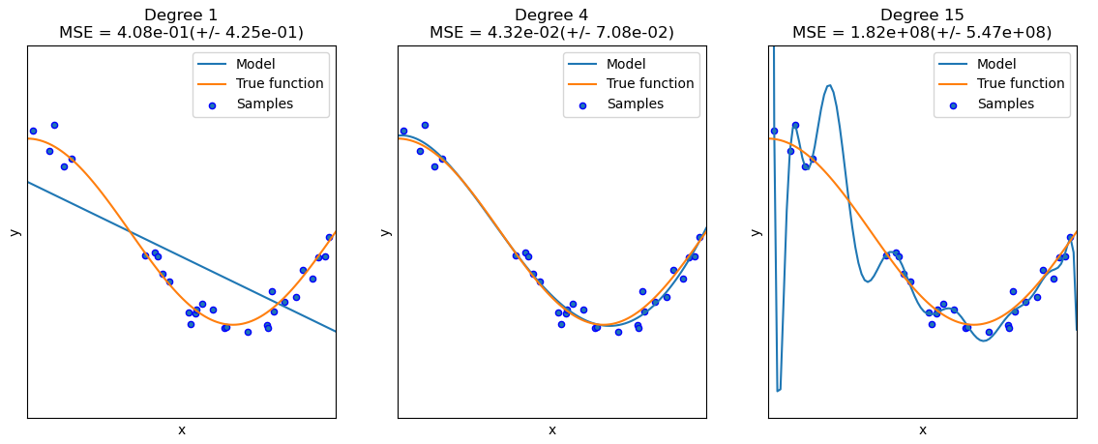
Under and overfitting: enemies of generalisation
https://scikit-learn.org/stable/auto_examples/model_selection/plot_underfitting_overfitting.html

Slide 56
Overfitting
Prone to over fitting when
Large number of variables (even if just noise)
# variables >> # samples
Model is very expressive
Evaluation is imperfect
If a result looks too good to be true, it probably is.

Slide 57
Interactive Session 2

Slide 58
Interactive session 2
Fit a few different models on the diabetes dataset
Explore different metrics
Explore different model outputs
Get greater familiarity with the tidymodels package

Slide 59
Return from interactive session 2
Metrics for binary tasks are often but not always quite correlated with each other
- Can vary more when datasets are imbalanced
- Can look quite different when we move to having multiple possible labels
Metrics for continuous values are a different kettle of fish
Different models can be extremely different in their outputs!
- Predictive performance may be the same but complexity/interpretability may vary dramatically.
- Computational costs can also vary a lot

Slide 60
Session 3: Evaluation frameworks & pitfalls
Part 1: Training, testing and information leakage

Slide 61
In this session
The right way to train models and evaluate them
Super critical any time you are making a predictive model

Slide 62
Evaluation framework
Data I have today
Data I want my model to make predictions on
Recall: Primary goal is model generalisation
If we have two datasets, life is easy (sort of)
Train model on one
Test on remaining
But what if we only have a single dataset?
Data I have today
???

Slide 63
Strategy 1: Super naive
Train model on the entire dataset
Evaluate performance on the same data you used to build the model
Pro:
Trivial
Con:
Provides no insight into generalisation!!
Despite that this happens regularly, it just tends to be hidden

Slide 64
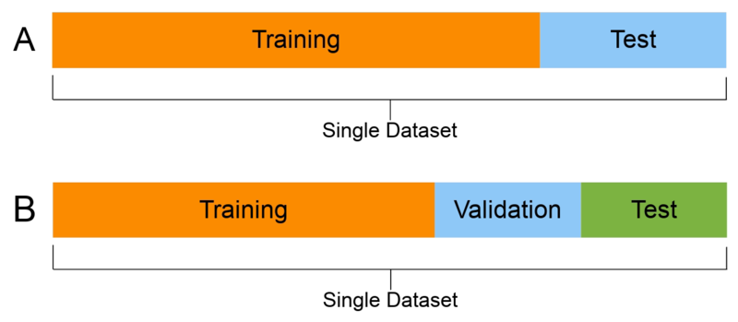
Strategy 2: Test/train
Split the data into two parts:
Use X% for training i.e model construction
Use 100-X% for testing i.e. model evaluation
If comparing models, best model has best test set score

Slide 65
Strategy 2: Test/train
Pros:
Very simple
Cons:
In small datasets, subject to sampling bias. i.e. maybe we select easy to classify samples, maybe we select hard to classify samples
Reduces amount of data used for model construction
Acceptable with large datasets and very computationally expensive models. But otherwise not ideal

Slide 66
Pitfall - Strategy 2: Test/train
Performance varies depending on how we split the data
What if we run 1000 times and only report the split that leads to best performance?
Improvement can be extremely large due to chance
Results look great, but don’t reflect average performance

Slide 67
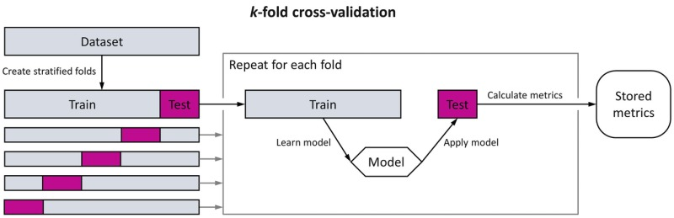
Strategy 3: (Repeated) K-fold cross-validation

Slide 68
Strategy 3: (Repeated) K-fold cross-validation
Split the data into K equal size parts (folds)
For each fold
Use all other folds, for training
Use fold as testing i.e. model evaluation
Constructs K models
Variant: repeat procedure R times to further reduce sampling bias. Construct R x K models
If comparing models, best model has mean/median test score

Slide 69
Strategy 3: (Repeated) K-fold cross-validation
Pros:
Provides robust estimates of performance
Uses all data in evaluation
Cons:
Computationally expensive
Can be difficult to interpret large number of models
Often used with small-medium datasets
Recommended for a wide range of problems!

Slide 70
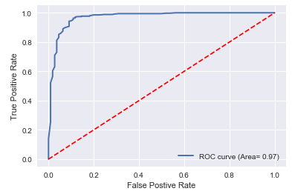
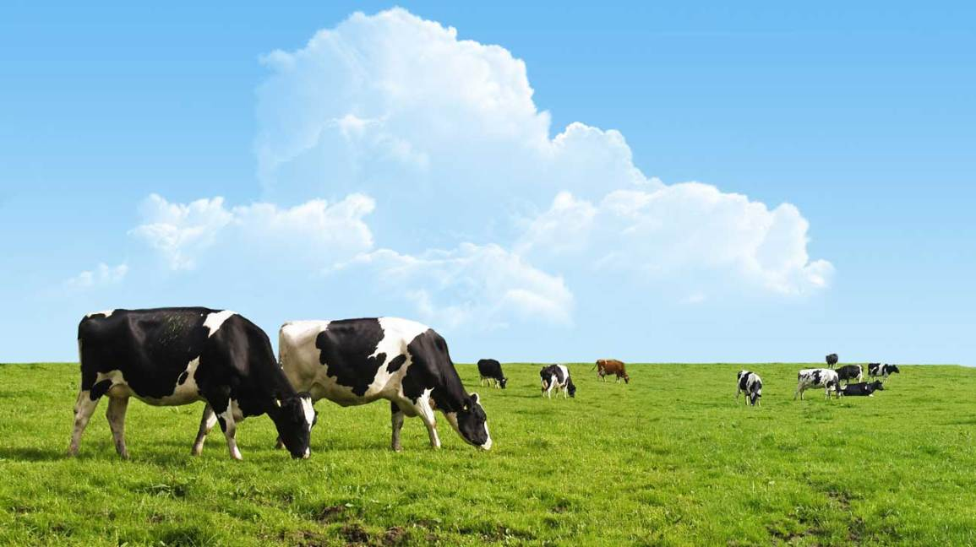
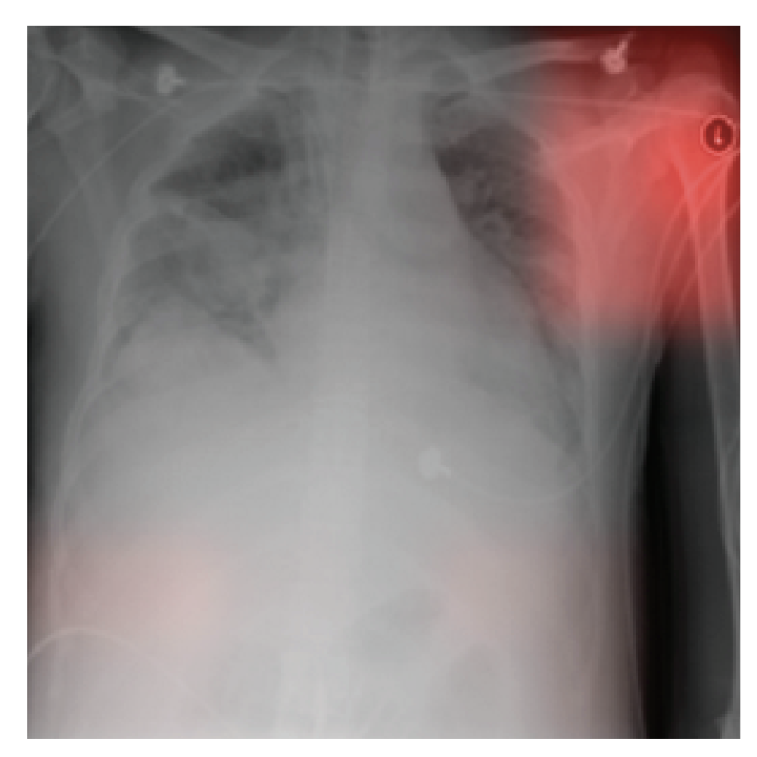
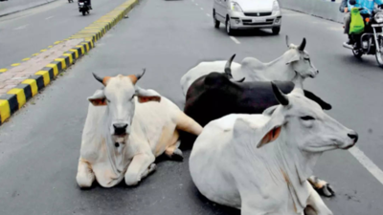
Data leakage and learning “uninteresting” things
Even when you cross validate, you need to make sure that you have no information about test dataset in your training dataset. This can be subtle.
Predict COW
Near perfect prediction - typically an indicator of data leakage
Learning hospital label in image instead of lung status
Predict CAR

Slide 71
Interactive Session 3

Slide 72
Interactive session 3
Fit some different machine learning classifiers
Evaluate performance using training/test split
Evaluate performance using k-fold cross-validation

Slide 73
Return from interactive session 3
Test train split sees large performance differences
More variables, more variability
Cross-validation takes a little time to run
Some models require careful parameter selection
7

Slide 74
Wrap-up of day 1
Machine learning = find patterns in one dataset that are robust enough to occur in “similar” datasets in the future
Supervised machine learning = we want to learn how to predict some output measurement from a set of “features”
Goal is (usually) robust prediction on future dataset
Generalizability is the key goal here!

Slide 75
Wrap-up of day 1
Lots of models and algorithms to learn this prediction exist
All make different assumptions
Often have some dials (“hyperparameters”) that need to be adjusted for your dataset
We will cover this tomorrow
Evaluation needs to emulate the situation where data is not seen by model
Care needs to be taken to ensure the “test” dataset is never used to inform the model building process
This is surprisingly difficult to achieve

Slide 76
Q/A
Questions

Slide 77
Applying machine learning in life sciences – Day 2:
What does it mean and how to avoid common traps
Ben Goudey
AI Technical Lead
Australia BioCommons

Slide 78
Ben Goudey: who am I?
AI Tech Lead: Figuring how AI is used in life-sciences, what the barriers are and how BioCommons can help to communities to overcome these
Academic Research
Industrial Research
Postdoc (23/24)
Research Scientist, 13-21
PhD, Comp Sci (2016)
Postdoc (21/22)
Now Data61
PhD, Comp Sci (2016)

Slide 79
Aim of this workshop
By the end of this two day workshop, you should be able to:
Give a high-level description of what machine learning is and what it can do
Understand the basics of evaluating supervised machine learning models
Recognise when evaluation of machine learning models might be optimistically biased
Have a passing familiarity with different models and metrics
Play around with some basic R code for implementing machine learning pipelines

Slide 80
Content across the two days
Tuesday (Day 1) | Wednesday (Day 2)
Intro to ML Basics of models and evaluation Cross-validation | 4. Tuning models 5. Real-world exploration 6. Discussion and Q/A
Lots of content, fast paced.
More about ideas and high level. Less about code and details Second day can be used to clarify content from first day

Slide 81
Classes of machine learning techniques
https://arxiv.org/abs/1910.05433

Slide 82
Different goals for supervised ML
Data enhancement/extraction
Multi-modal fusers
Harmonise, impute and standardize
Extract key features and signals.
Combine omics, imaging & cognition into a single disease signature
Quantify predictive value
Personalized risk predictors
Establish how much value measurements actually contribute to prediction on unseen data
Use risk factors to estimate a risk score or time to event, ideally driving intervention
Notes:
And really we covered a lot of different ways that machine learning could be used from data enhancement to quantifying the predictive value of different measurements. But I was always interested in this aspect around personalized risk prediction in AD. One issue was the value of knowing your risk was always of limited value given we had no interventions.

Slide 83
Supervised learning
Given:
A matrix of data X_{n x p}
A vector of labels y_{n}
learn a function f(X) that takes X and predicts y
More observations, better fit
Classic example is linear regression
$$y=∑β_{i}x_{i}$$
Linear regression being fit with increasing number of observations

Slide 84
Primary goal: Generalisable predictive model
Data to train model (labels known)
Data we want model to work on (labels unknown)
Can we make a predictive model that will work on data that wasn’t used to train it?
How do we know if we can make predictions on data if we don’t have that data yet?
https://www.nature.com/articles/s41746-024-01127-3/figures/1
Notes:
Imagine we want to construct a model to predict disease progression
For example, could be from pre-diabetic to diabetic in 12 months
We have access to some data from past patients
Use this data to construct model
Our goal is to build a model that works for future patients
Model should provide accurate estimate of who will progress and who will not

Slide 85
Cool models but when do these models help?
We want the models we create on a given set of data to work on the datasets we want to apply the models to
Data I want my model to make predictions on
Data I have today
Collected in the future
Collected in a different country
Collected with a different cohort design

Slide 86
Under and overfitting: enemies of generalisation
https://scikit-learn.org/stable/auto_examples/model_selection/plot_underfitting_overfitting.html

Slide 87
Evaluation framework
Data I have today
Data I want my model to make predictions on
Recall: Primary goal is model generalisation
If we have two datasets, life is easy (sort of)
Train model on one
Test on remaining
But what if we only have a single dataset?
Data I have today
???

Slide 88
Cross-validation

Slide 89
Session 4: Feature selection, hyperparameter tuning & model section

Slide 90
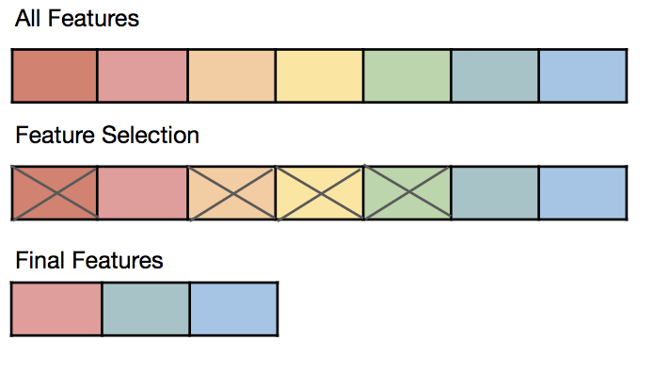
Irrelevant features
Especially in ‘omics data, only a subset will be relevant to the outcome we want to predict
Often we hypothesises or explicitly know that only a subset of features are relevant for a given predictive task
Feature selection is the act of selecting only a subset of measurements need for the task

Slide 91
Including irrelevant variables can:
Reduce interpretability
a model with 10,000 measurements to consider is harder to interpret than one with 10 measurements
Reduce translational impacts
we may have measured lots of things using an expensive approach but want to find a small panel that can be commercialized
Impact model robustness/performance
including lots of noise is adding variability
Increase computational/storage/preprocessing requirements and costs

Slide 92
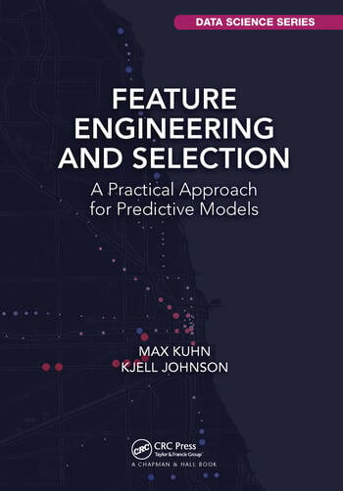
How do I do feature selection
It’s a big topic! Options include:
Domain expertise
Picking the top features based on their individual discriminative ability
Fold change, Effect size etc
Picking features based on some iterative process
Stepwise selection etc
Some models do this inherently
Lasso is a clear example
https://bookdown.org/max/FES/

Slide 93
Example in our diabetes data
Only ~15 measurements but still we may want to simplify
One idea: look at the strength of association each feature has individually with our diabetes outcome
Measure `strength of association` via logistic regression using significance of coefficient as the measure
Rank features by significance
Take the top `k`

Slide 94
Issues that come up
On what data do I do this?
How do I pick `k`? Is this obvious?
What if I have correlated features?
What if I have both categorical and continuous features?
This always happens and is not always obvious

Slide 95
How many features to pick?
Sometimes this question might be fully determined by the context you want to use your model in
Example: I need 10 genetic variants because I have a very specific array I want to use and that’s all it supports
But most of the time, this is yet another “hyperparameter” that you need to figure out
Same as those in out models

Slide 96
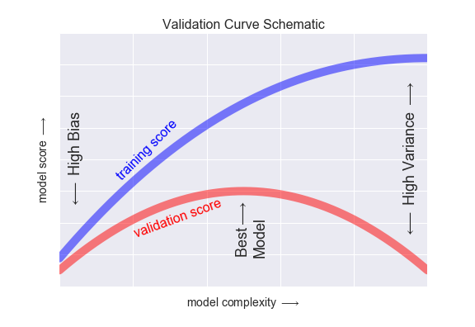
Picking hyper-parameters
Many models have parameters that control how complex they are:
Tree depth in decision trees
Regularisation penalty in penalized regression
Tree depth and features per node in Random forests
These are called hyperparameters, parameters of the model, not of the measurements.
Underfitting
Overfitting

Slide 97
How do we determine a final model
There’s a lot of options in predictive modelling:
What model to pick?
What features to include?
What parameters to set?
How can we do this in a way that is robust to over-fitting?

Slide 98

Strategy 1: Decide, then Test/train
Data
Peek at entire dataset, see which parameters work well, then run cross-validation.
Why is this wrong?
Pick best option, then train model

Slide 99
Strategy 1: Decide, then Test/train
Data
Peek at entire dataset, see which parameters work well, then run cross-validation.
Why is this wrong?
The test dataset is no longer with held! Its been used to optimise model choices
DO NOT DO THIS!
Pick best option, then train model

Slide 100
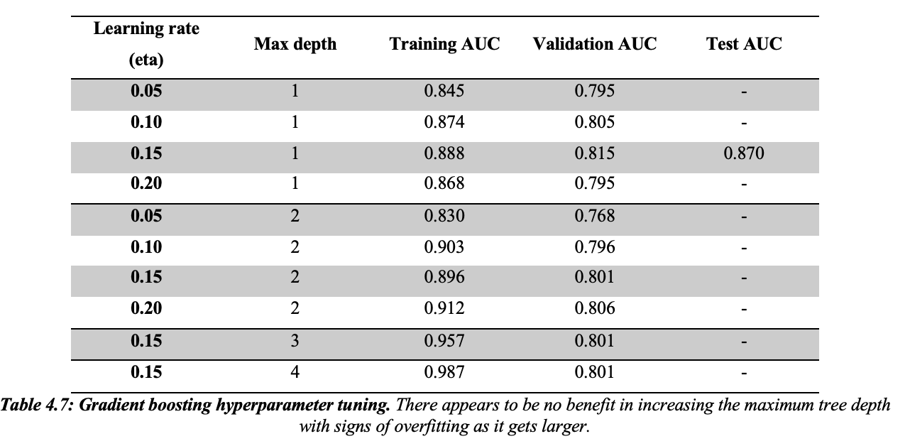
Strategy 2: Decide, then Test/train
Add a third split of data, use it to evaluate all models, select the best model to evaluate on test dataset
Can peek at validation but never at test
Training
Validation
Test

Slide 101
Potential downsides of Strategy 2
Same as we had with a we had with a single test/train split
Solution 1 – do this in cross validation.
Models are made on training, best is selected on validation and reported evaluation is on the held-out test data.
Training
Validation
Test
Training
Validation
Test
Training
Validation
Test
Training
Validation
Test
Training
Test
Training
Validation

Slide 102
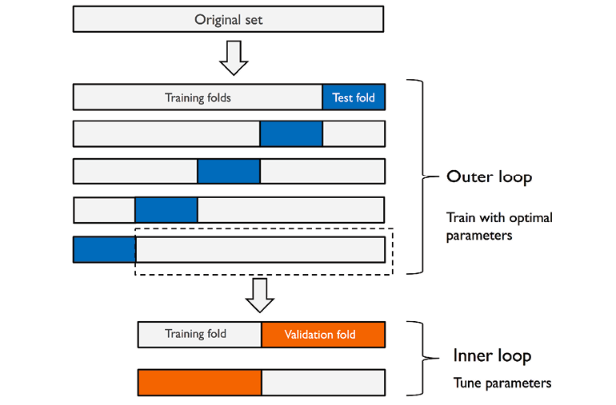
Strategy 3: repeated and nested cross-validation
Downside: “model selection” in each fold is just on a single training/validation split in each fold
Maybe we end up overfitting here? (especially in small datasets)
Solution: add another cross-validation loop, this time nested within our first loop!
+ More robust model selection
- Can get computationally expensive.
https://sebastianraschka.com/blog/2016/model-evaluation-selection-part3.html

Slide 103
Practical comments
Model building and selection can never-ever see the test data.
Ideally all steps (imputatation, pre-processing, feature selection, model fitting) are all done in each cross-validation fold independently.
Feature selection and tuning of model complexity can lead to very overly optimistic performance
But others (imputation, fixing feature skew etc) may have very little impact and doing this on the whole data may be more practical
Lots of subtle ways we can accidentally leak data from test datasets into training datasets
We’d prefer the held-out data to represent real-world usage. Rather than random folds, stronger to base it on sites, cohorts, time
Some decisions may be explored as part of testing your research hypothesis, e.g. select features based on some research question, explore a few models and report differences

Slide 104
Something to keep in mind as well
Idea: Fit many models on training data, pick the “best” model in each validation, test on held-out
May prefer to pick the simplest model that still has performance close to “best”.
e.g within 1 standard deviation of best AUC but has fewest features
“Everything should be made as simple as possible, but not simpler.” - Albert Einstein
Underfitting
Overfitting

Slide 105
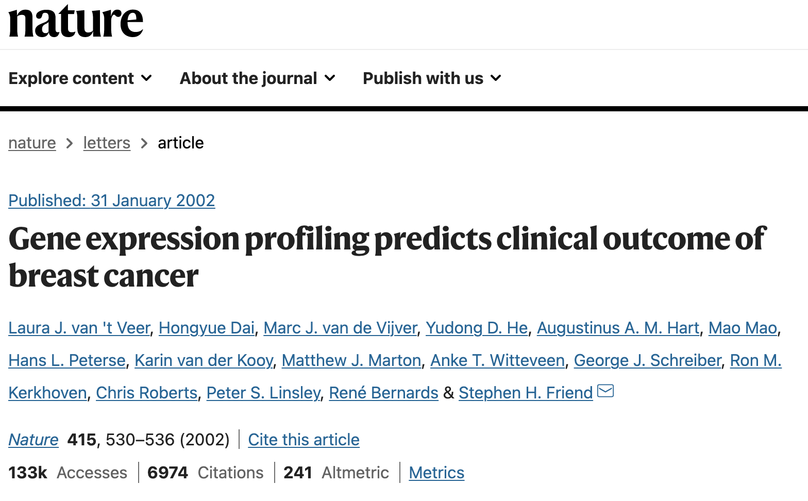
When have people screwed this up?

Slide 106
When have people screwed this up?
Microarray panel of gene expression data(n=117)
70 genes predict five-year metastases with 78% accuracy
Model used “leave-one out cross-validation”

Slide 107
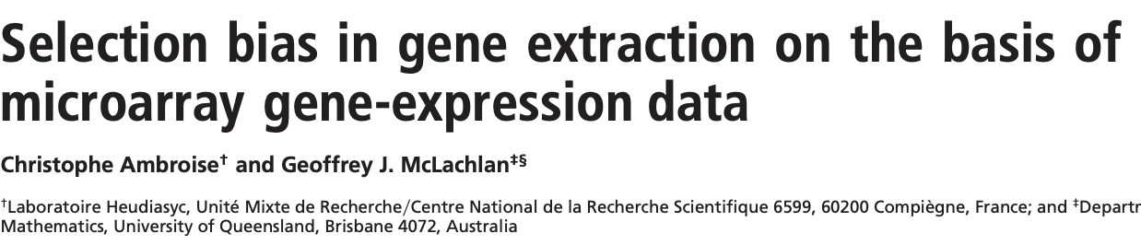
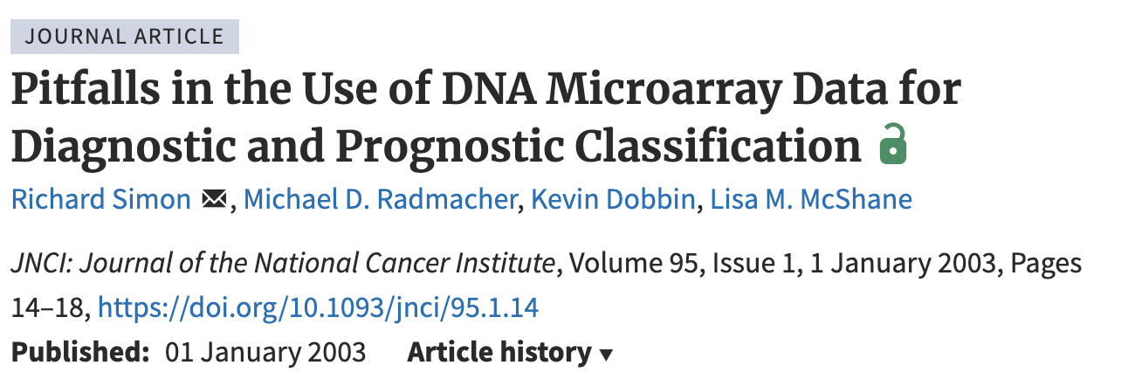
When have people screwed this up?
Simon et al (2003) and Ambroise and McLachlan (2003) both highlighted that gene (feature) selection took place on whole dataset (outside of CV).
If CV is done correctly, performance drops to 59%

Slide 108

But Ben, people don’t make that mistake any more, right?

Slide 109

Experimental design is a hugely problematic area still
https://reproducible.cs.princeton.edu/
Kapoor, S. and Narayanan, A., 2023. Leakage and the reproducibility crisis in machine-learning-based science. Patterns, 4(9).

Slide 110
Session conclusions
Feature selection and hyperparameter optimisation are both types of model selection
Both provide opportunities to overfit the data
Nested cross-validation provides a path, albeit an expensive one, to select models while providing robust estimates of performance

Slide 111
Interactive Session 4

Slide 112
Interactive session 4
Evaluate impact of feature selection when conducted naively
Conduct feature selection via nested cross-validation
Conduct hyperparameter selection via nested cross-validation

Slide 113
Return from interactive session 4
Test train split sees large performance differences
More variables, more variability
Cross-validation takes a little time to run
Some models require careful parameter selection

Slide 114
Session 5: A real world example

Slide 115
Concepts and tools we’ve learnt about so far
Models
Metrics
Evaluation frameworks
Feature selection
Hyperparameter tuning
…and the code to implement all of these

Slide 116
Different goals for supervised ML
Data enhancement/extraction
Multi-modal fusers
Harmonise, impute and standardize
Extract key features and signals.
Combine omics, imaging & cognition into a single disease signature
Quantify predictive value
Personalized risk predictors
Establish how much value measurements actually contribute to prediction on unseen data
Use risk factors to estimate a risk score or time to event, ideally driving intervention
Notes:
And really we covered a lot of different ways that machine learning could be used from data enhancement to quantifying the predictive value of different measurements. But I was always interested in this aspect around personalized risk prediction in AD. One issue was the value of knowing your risk was always of limited value given we had no interventions.

Slide 117
Different goals for supervised ML
Data enhancement/extraction
Multi-modal fusers
Harmonise, impute and standardize
Extract key features and signals.
Combine omics, imaging & cognition into a single disease signature
Quantify predictive value
Personalized risk predictors
Establish how much value measurements actually contribute to prediction on unseen data
Use risk factors to estimate a risk score or time to event, ideally driving intervention
Notes:
And really we covered a lot of different ways that machine learning could be used from data enhancement to quantifying the predictive value of different measurements. But I was always interested in this aspect around personalized risk prediction in AD. One issue was the value of knowing your risk was always of limited value given we had no interventions.

Slide 118
Recall the data we are using
Originally the dataset was to
“investigate the association between body mass index (BMI) and diabetes across a wide range of age groups.
But what if ask it as a predictive question:
does BMI improve prediction of incident diabetes between 2 and 7 years from onset?
There are lots of questions here to unpack!
Notes:
And really we covered a lot of different ways that machine learning could be used from data enhancement to quantifying the predictive value of different measurements. But I was always interested in this aspect around personalized risk prediction in AD. One issue was the value of knowing your risk was always of limited value given we had no interventions.

Slide 119
Implementation plan
Make a model to predict “diabetes” outcome using BMI on the Chen dataset. Assume maybe we want to show a few different types of models?

Slide 120
Code snippet
Make a model to predict “diabetes” outcome using BMI on the Chen dataset

Slide 121
Does BMI improve prediction of incident diabetes between 2 and 7 years from onset?
Improve beyond what?
The original paper was looking at BMI and controlling for age, sex, and blood glucose
So for us, lets assume our “baseline” model is age, sex, and blood glucose.
Selection of an appropriate baseline is critical to getting any sort of insights out of your model
Results can look great with a poor baseline but I regularly request for stronger baselines in my reviews
Notes:
And really we covered a lot of different ways that machine learning could be used from data enhancement to quantifying the predictive value of different measurements. But I was always interested in this aspect around personalized risk prediction in AD. One issue was the value of knowing your risk was always of limited value given we had no interventions.

Slide 122
Implementation plan
Make two models to predict “diabetes” outcome using Chen dataset
One with age, sex, and blood glucose.
One with age, sex, and blood glucose AND BMI.

Slide 123
Does BMI improve prediction of incident diabetes between 2 and 7 years from onset?
“Improve prediction” - how do we quantify this?
AS described yesterday this is very context specific
Metrics are often chosen by
a) appropriateness to the task
b) what other people do in this area (regardless of whether its appropriate
Notes:
And really we covered a lot of different ways that machine learning could be used from data enhancement to quantifying the predictive value of different measurements. But I was always interested in this aspect around personalized risk prediction in AD. One issue was the value of knowing your risk was always of limited value given we had no interventions.

Slide 124
Implementation plan
Make two models to predict “diabetes” outcome using Chen dataset
One with age, sex, and blood glucose.
One with age, sex, and blood glucose AND BMI.
Measure performance using
AUC
Brier Index – like mean squared error but for classification.

Slide 125
Implementation plan
Make two models to predict “diabetes” outcome using Chen dataset
One with age, sex, and blood glucose.
One with age, sex, and blood glucose AND BMI.
Measure performance using
AUC
Brier Index
Use leave-one-site-out cross-validation to simulate having trained on all sites except one

Slide 126
What models, features or hyper-parameters will I use?
Hard to know up front.
Logistic regression - very simple
Logistic regression with regularisation (Lasso) - simple but drops features
Random Forest - non-linear fit, less useful when few features
Feature selection limited to Lasso
Use nested CV to tune one parameter that controls complexity
Alpha in Lasso
Tree depth in Random forest
Notes:
And really we covered a lot of different ways that machine learning could be used from data enhancement to quantifying the predictive value of different measurements. But I was always interested in this aspect around personalized risk prediction in AD. One issue was the value of knowing your risk was always of limited value given we had no interventions.

Slide 127
Implementation plan
Make two models to predict “diabetes” outcome using Chen dataset
One with age, sex, and blood glucose.
One with age, sex, and blood glucose AND BMI.
Select from three models, logistic regression with and without L1 and Random Forest. Each model is tuned using a 3-fold CV within the training dataset (i.e. using nested CV)
Performance is measured using AUC and Brier Index

Slide 128
Interactive Session 5

Slide 129
Interactive session 5
Try to implement the plan for the analysis above. Use the code previously given to start to analyse the problem

Slide 130
Return from interactive session 5
What can be said?

Slide 131
How will we simulate the held-out set(s) for prediction?
In the code, I took two subsets of participants from different sites and used a test/train split of these.
Using different sites means we capture some real-world differences, more than if we randomly split
What would an even stronger approach be?
Notes:
And really we covered a lot of different ways that machine learning could be used from data enhancement to quantifying the predictive value of different measurements. But I was always interested in this aspect around personalized risk prediction in AD. One issue was the value of knowing your risk was always of limited value given we had no interventions.

Slide 132
How will we simulate the held-out set(s) for prediction?
In the code, I took two subsets of participants from different sites and used a test/train split of these.
Using different sites means we capture some real-world differences, more than if we randomly split
What would an even stronger approach be?
Leave-one-site out cross-validation
Notes:
And really we covered a lot of different ways that machine learning could be used from data enhancement to quantifying the predictive value of different measurements. But I was always interested in this aspect around personalized risk prediction in AD. One issue was the value of knowing your risk was always of limited value given we had no interventions.

Slide 133
Session 6: Common issues in machine learning in life sciences

Slide 134
Summary of today
Basic concepts of machine learning (prediction not attribution)
Explored supervised learning, in particular classification
Touched on a few algorithms
Described experimental design for ML
But there is a wealth of information not covered.

Slide 135

Data changes over time
Often we collect data from different sources and the relationships between variables may differ:
equipment (scanners, assays etc)
environment, people, process
cohorts and study design
Depending on the issue, you may want to harmonize datasets (make them more similar) using statistical methods
OR
You may need to train a classifier that can be robust to distribution shifts.

Slide 136

Measurement noise
Often, we might measure something and know there is measurement noise.
It is possible to integrate this knowledge into your models:
Bayesian model allow you to integrate this information but can be complex to fit
Can up-weight or down weight features based on prior knowledge
Extensions of some models exist that can treat observed values as distributions rather than exact numbers
Notes:
https://training-course-material.com/training/Statistics_for_Decision_Makers_-_06.02_-_Research_Design_-_Measurement

Slide 137
Complicated datasets
Longitudinal datasets?
Look for models that can incorporated temporal relationships (survival or mixed linear models often have ML extensions)
Lots of weird structure in my data (relationships between samples)?
Graph based models exist that can incorporate lots of relationships
Hierarchical information can also be represented in certain types of linear mixed models and their extensions
Often datasets are reframed as cross-sectional tasks, even if they aren’t exactly

Slide 138

How big does my sample size need to be?
Very hard to estimate.
How many features do you have?
How strong is the association between features and outcome?
Power analysis is not exactly a thing for ML
It can be if your final result is a statistical test again some baseline model
If you have pilot dataset, try to build a model and vary sample size

Slide 139

ML in practice – SepsisWatch
Duke University implemented screening tool for sepsis (life-threatening complication of infection)
32 million training examples
Once model was successful, the hospital had to radically change the systems in which their staff operated

Slide 140

But what about Deep Learning?!
If we have enough data with the right sort of structure, we could get our algorithm to learn features as well as construct classifiers.
This is one simplified view of how deep learning works
Requires the ”right” sort of data and someone needs to have lots of it
Text, video, protein structure/sequence
…the list is growing
For small datasets or where measurements are “non-standard”, its probably not for you
See Deep learning for tabular data
Notes:
Image from https://quantdare.com/what-is-the-difference-between-deep-learning-and-machine-learning/

Slide 141
Other facets
Statistical comparisons between models
Reporting standards in manuscripts (e.g. TRIPOD)
Pre-processing as part of model development
Unsupervised learning (clustering)

Slide 142
Further resources
Andriy Burkov, ” The Hundred-Page Machine Learning Book” (2019) https://themlbook.com/ - Covers many of the topics I describe today
James et al, ”An Intro to Statistical Learning” – very detailed textbook, great reference but a bit less less applied.
Aurélien Géron, "Hands-On Machine Learning with Scikit-Learn, Keras, and TensorFlow, 2nd Edition" 2019

Slide 143
Further resources
If you like R, check out tidymodels and associated packages (https://www.tidymodels.org/).
And all of today’s materials are available in R, see https://github.com/bwgoudey/IntroMLforLifeScienceWorkshopR
Scikit-learn website has a lot of great documentation https://scikit-learn.org/

Slide 144
Conclusions
Machine learning is a useful set of tools: its lots of fun to try and predict important outcomes with whatever data you have at hand
But its easy to fool yourself and others if you aren’t careful. Great for publication, not great for science.
Always try to carve off at least one chunk of data to act as a hold-out set, untouched by any model construction. For bonus points, do this repeatedly.
While we’ve only covered supervised learning and in particular classification. The same ideas all hold in unsupervised learning, where we try to learn which features identify similar groupings.

Slide 145
Q & A

